Slide 1
Mobile Application Development
David Drohan (ddrohan@wit.ie)

Slide 2
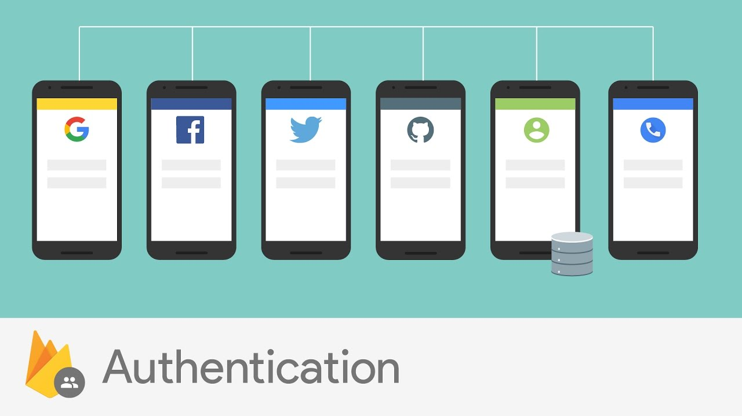

Firebase Authentication
All goodness bundled as one…

Slide 3
Overview
Most apps need to know the identity of a user. Knowing a user's identity allows an app to securely save user data in the cloud and provide the same personalized experience across all of the user's devices
Firebase Authentication provides backend services, easy-to-use SDKs, and ready-made UI libraries to authenticate users to your app. It supports authentication using passwords, phone numbers and popular federated identity providers (later)

Slide 4
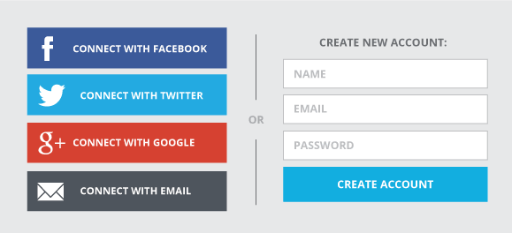
Overview
A type of screen present in almost all apps these days…
How long would it take you to develop this???
What about forgot password flow with email??

Slide 5
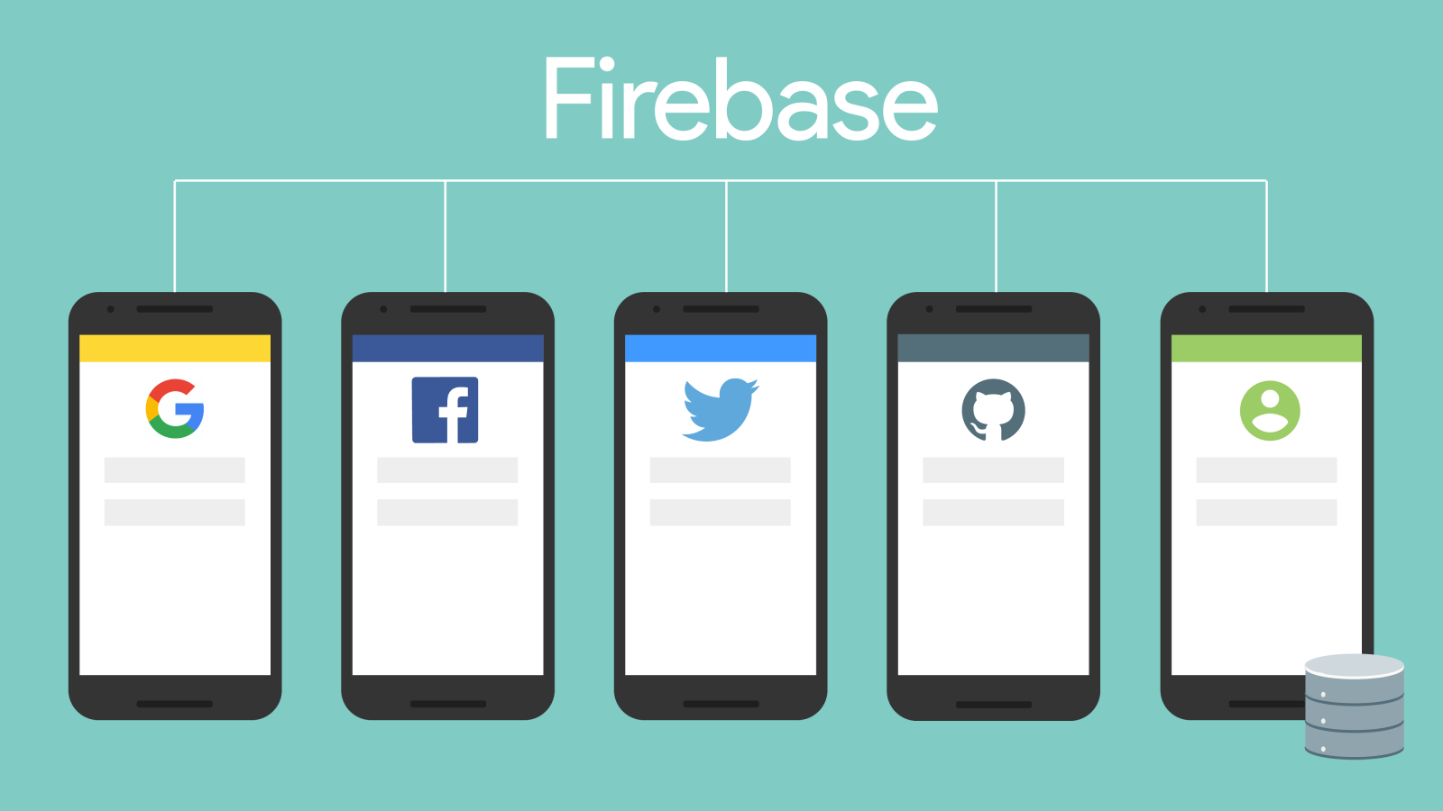
Overview
Integrate easily with popular identity providers like Google, Facebook, Twitter and more

Slide 6
Key Capabilities
You can sign in users to your Firebase app either by using FirebaseUI as a complete drop-in auth solution or by using the Firebase Authentication SDK to manually integrate one or several sign-in methods into your app
The Firebase Authentication SDK provides methods to create and manage users that use their email addresses and passwords to sign in
Firebase Authentication also handles sending password reset emails

Slide 7
Firebase Authentication
Of course you will need to register your app with individual service providers.
Minimal client side handling, integrates seamlessly with firebase
Ready made ‘forgot password’ flow with customizable email template
Notes:
Show google integration in app
Show template in console

Slide 8
Firebase Authentication

Slide 9
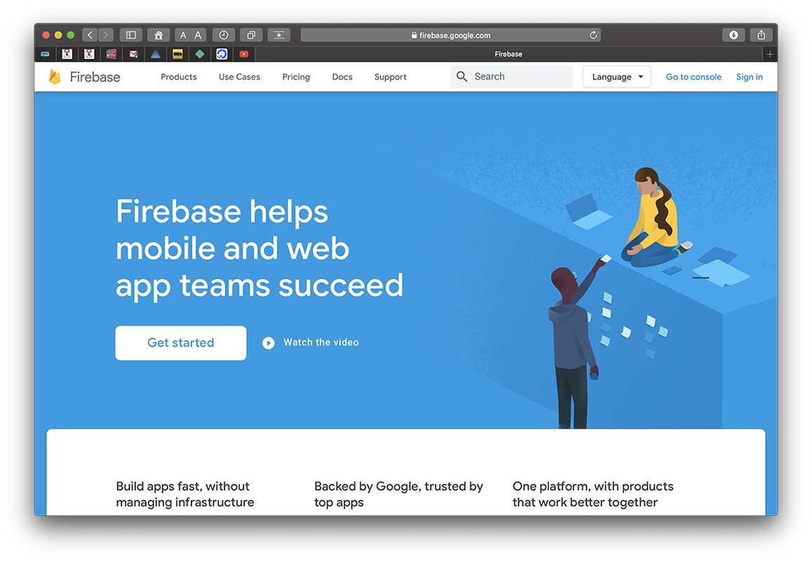
1. Create your Firebase Project

Slide 10
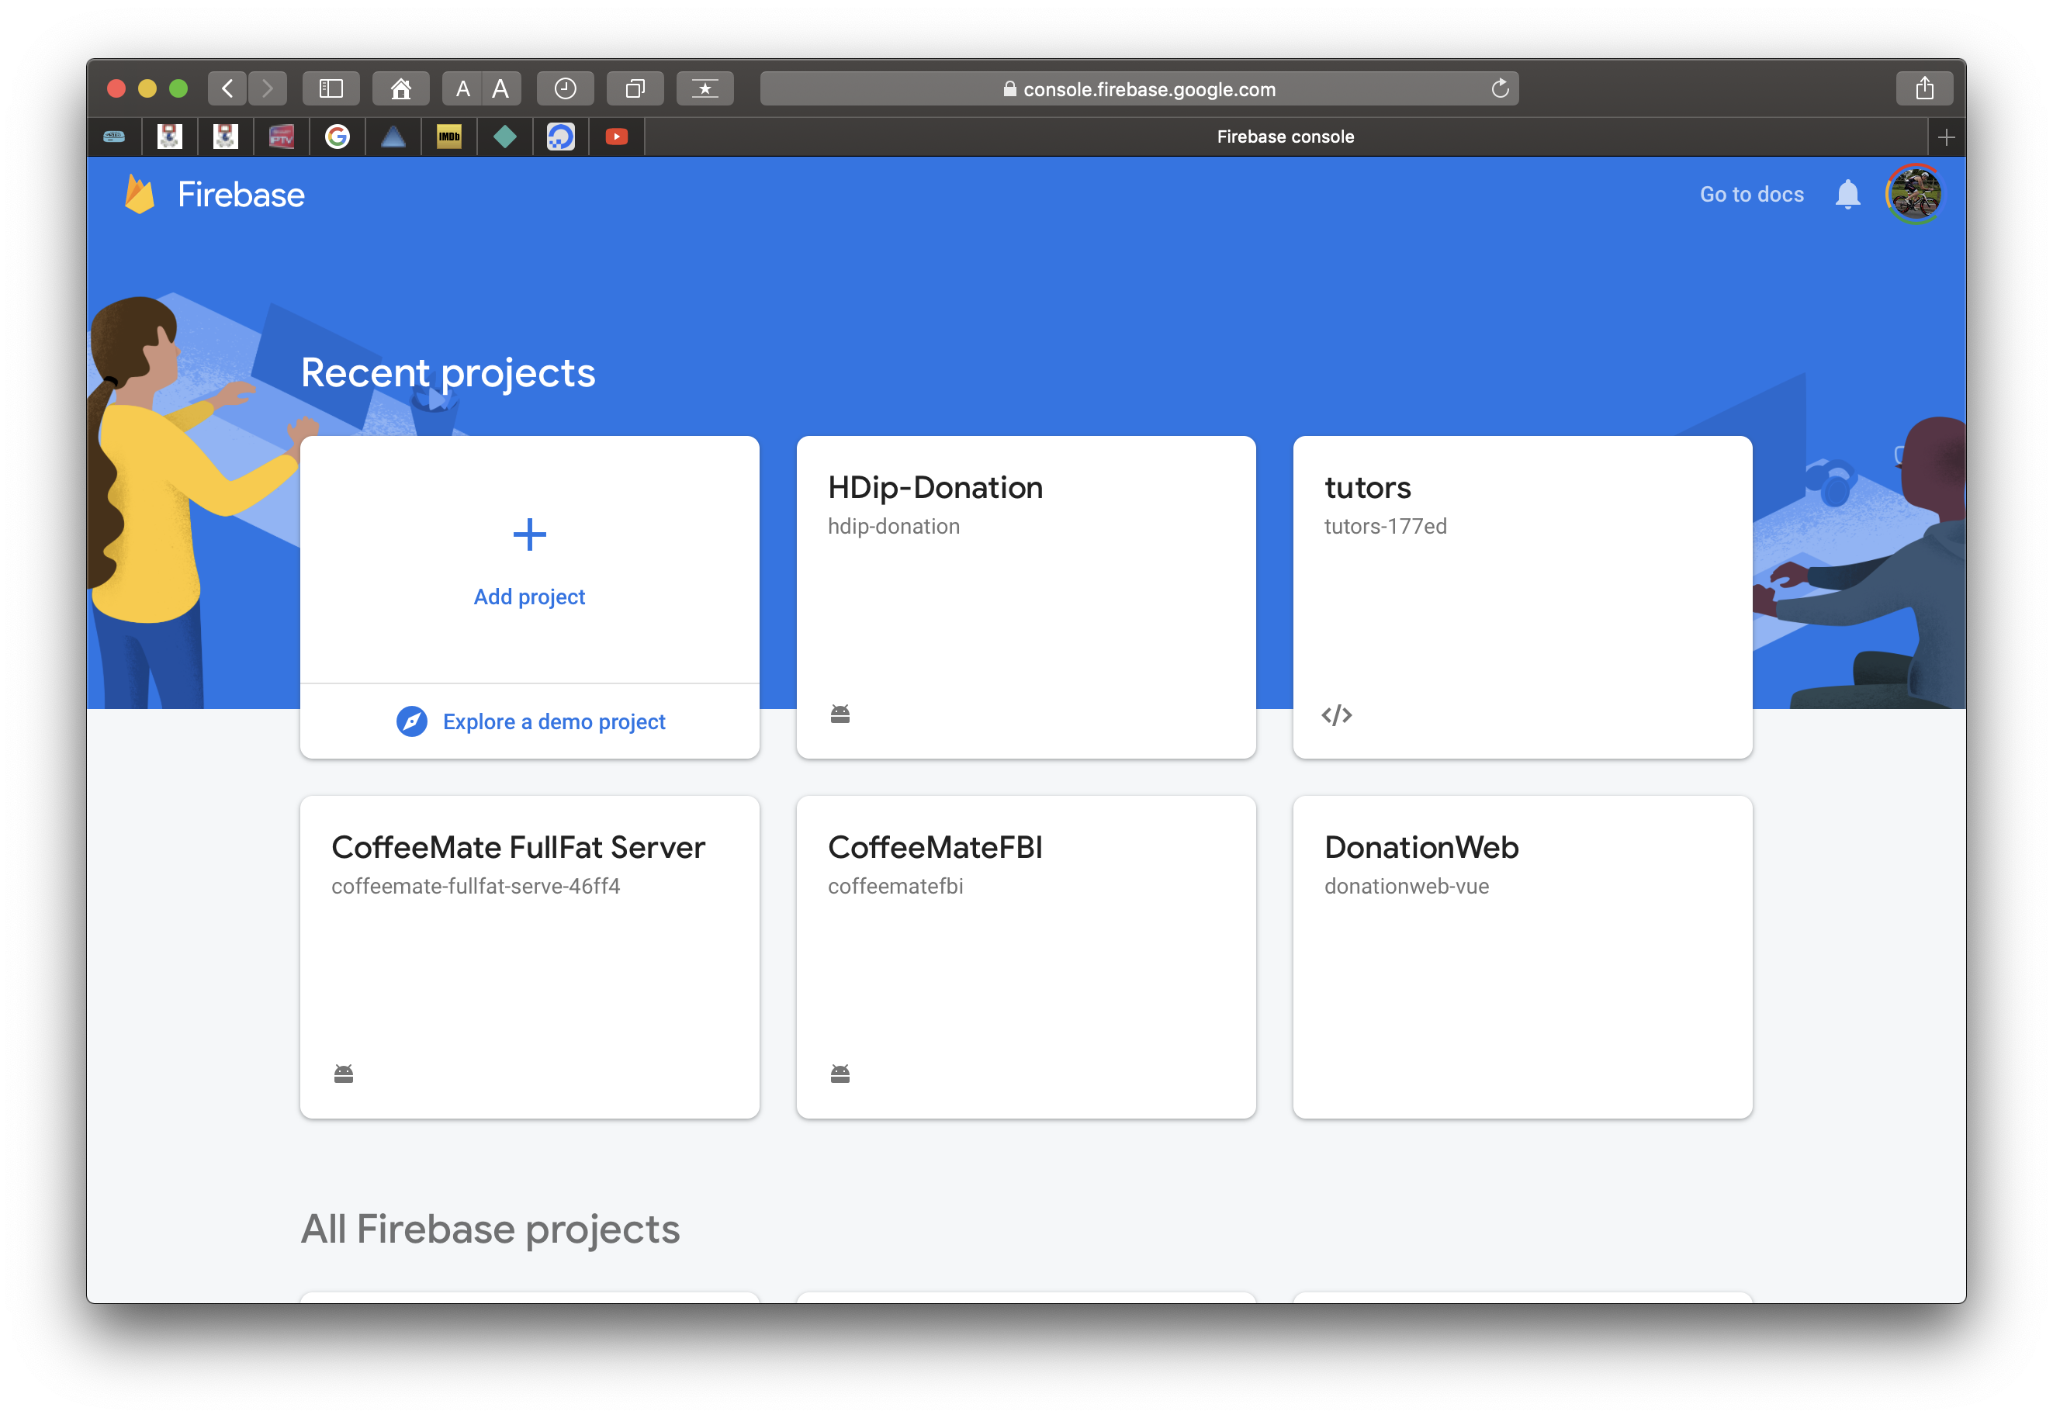
1. Create your Firebase Project

Slide 11
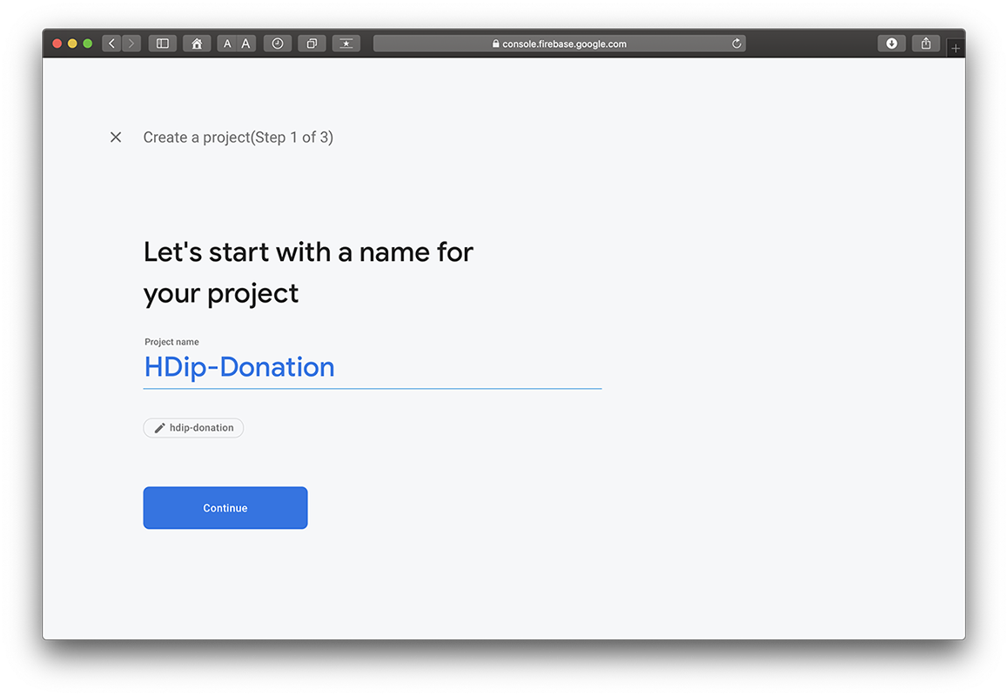
1. Create your Firebase Project

Slide 12
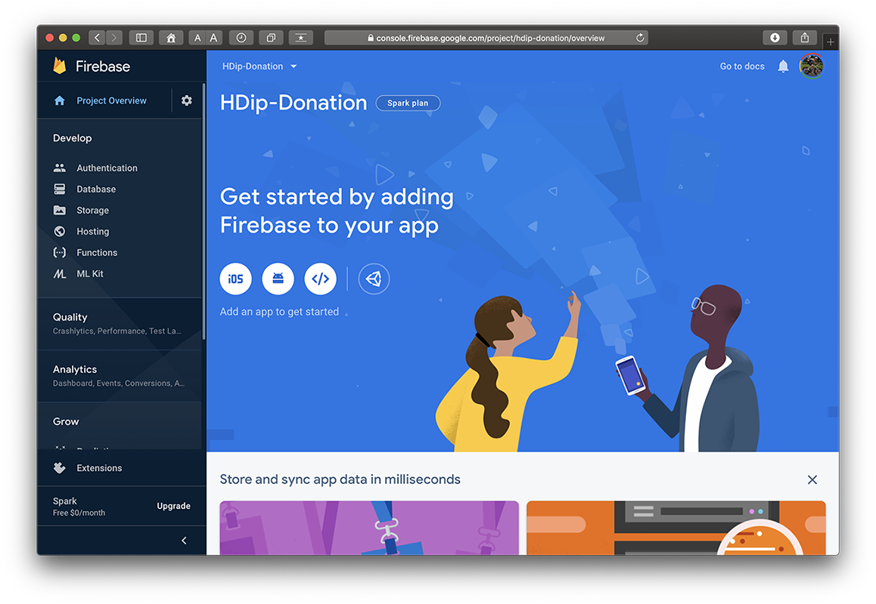
1. Create your Firebase Project

Slide 13
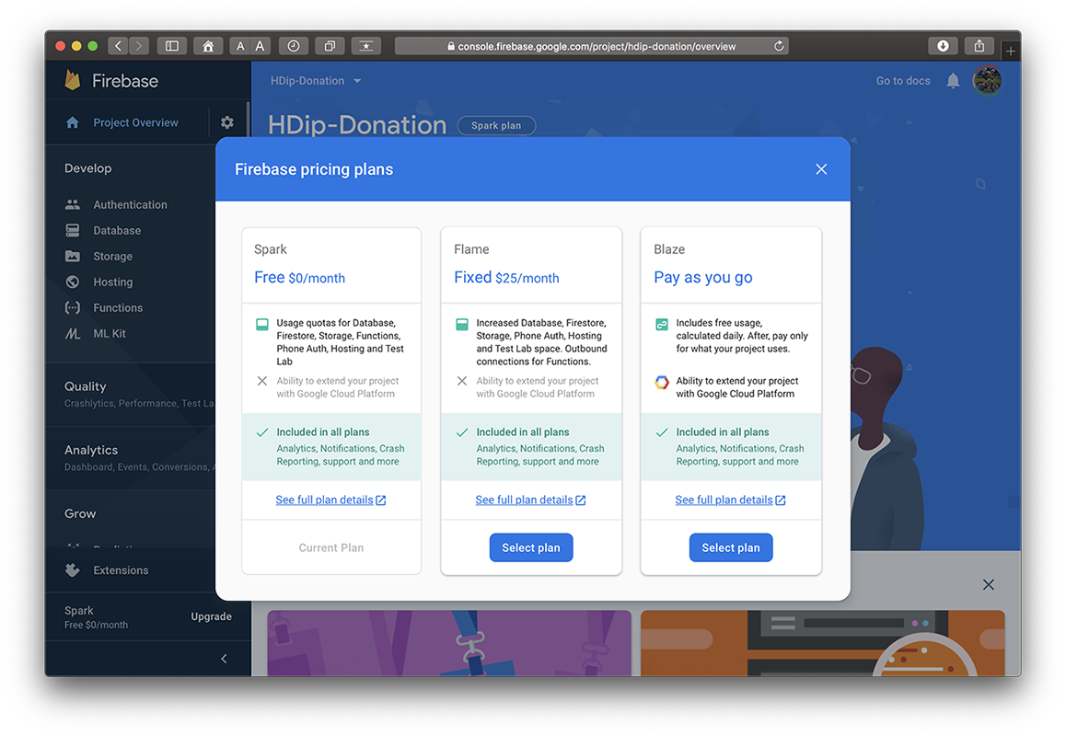
1. Create your Firebase Project

Slide 14
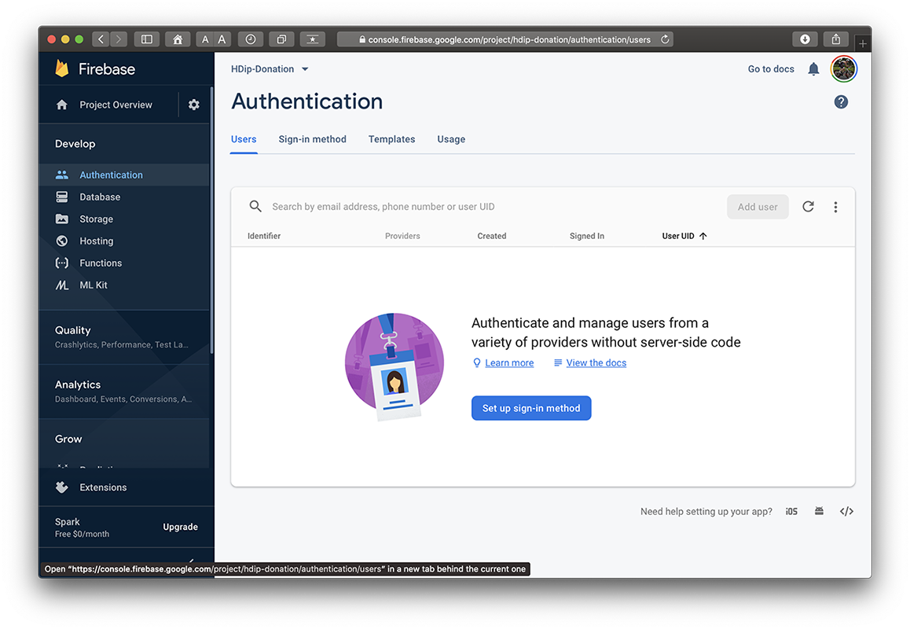
2. Setup your Sign-In Method

Slide 15
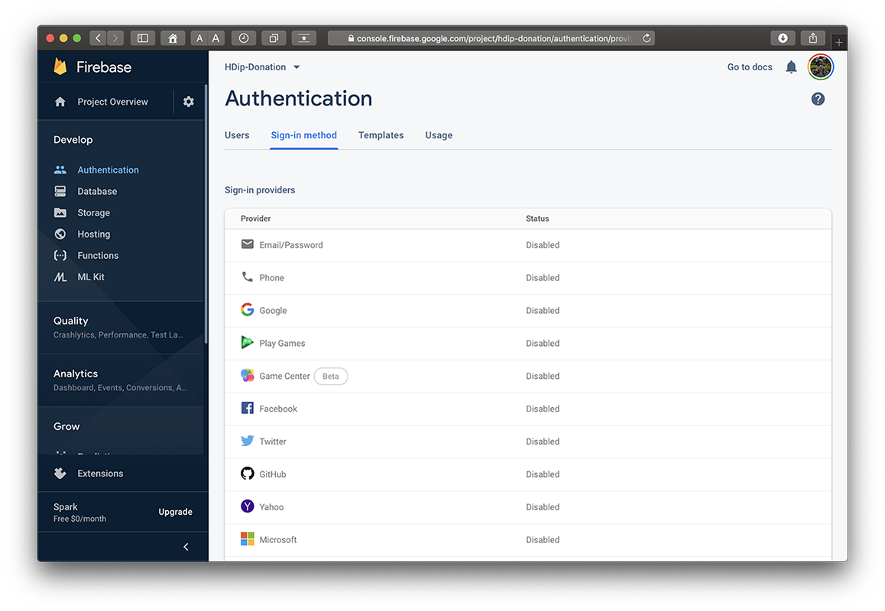
2. Setup your Sign-In Method

Slide 16
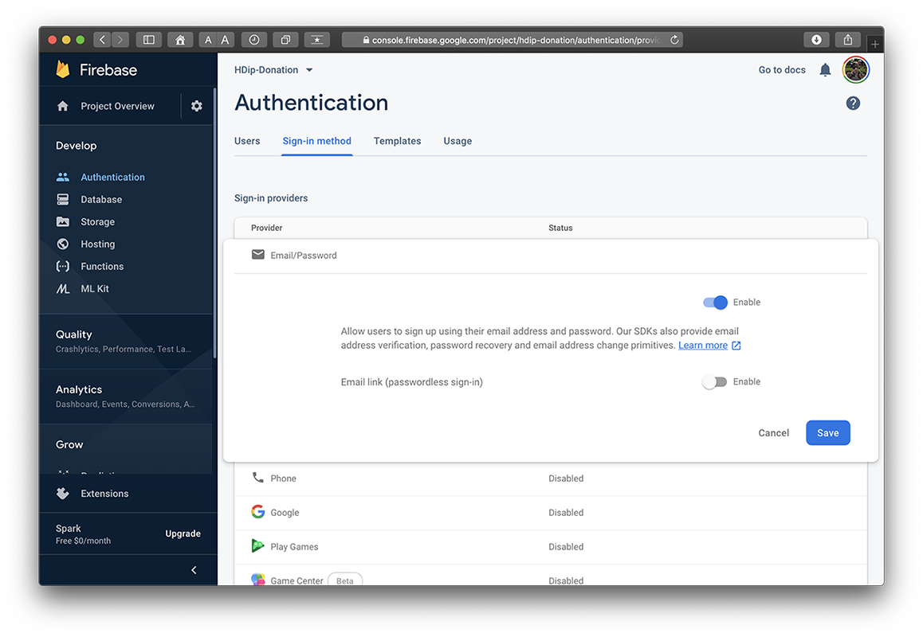
2. Setup your Sign-In Method

Slide 17
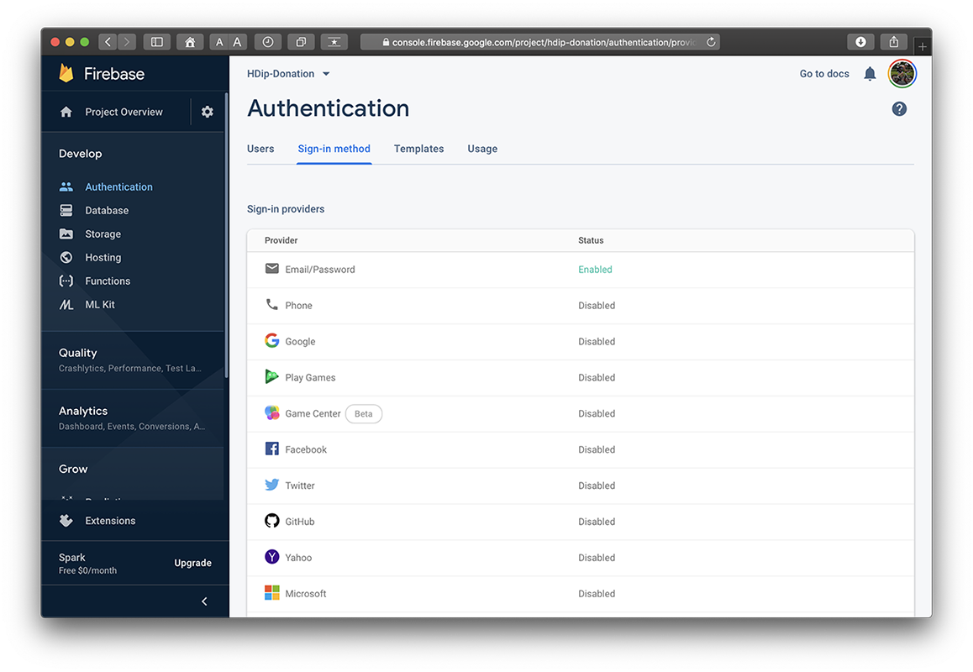
2. Setup your Sign-In Method

Slide 18
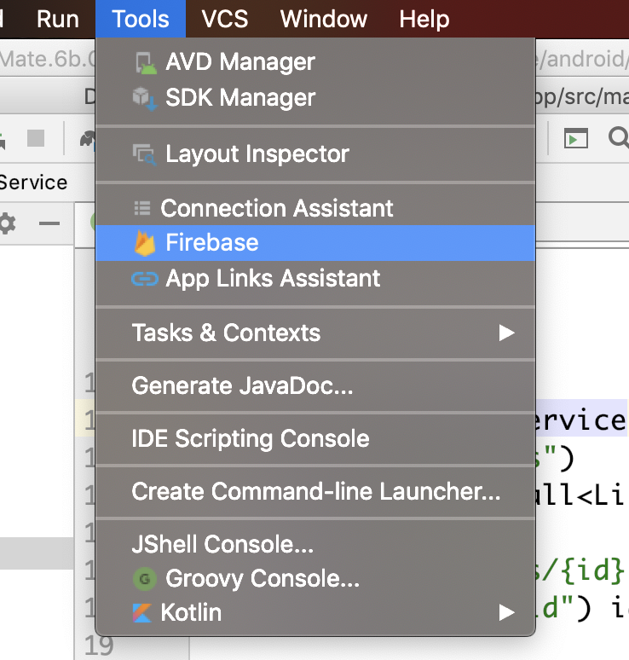
3. Setup Firebase in your App

Slide 19
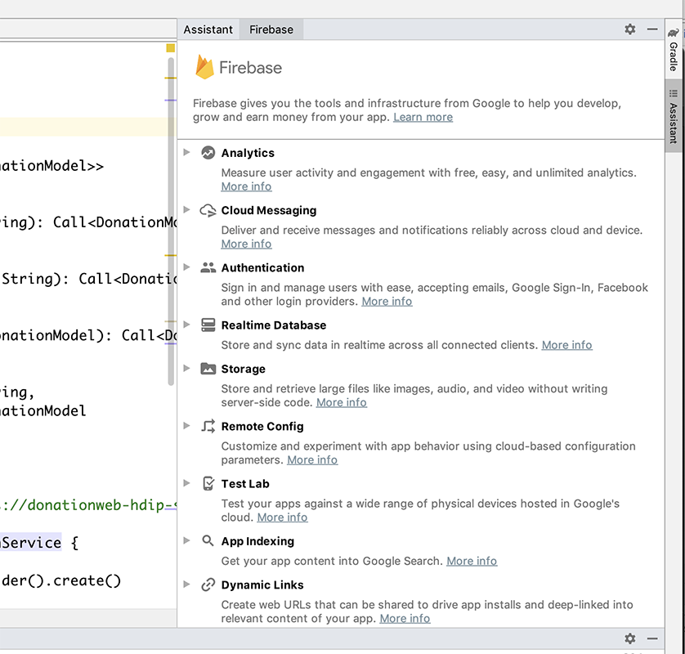
3. Setup Firebase in your App

Slide 20
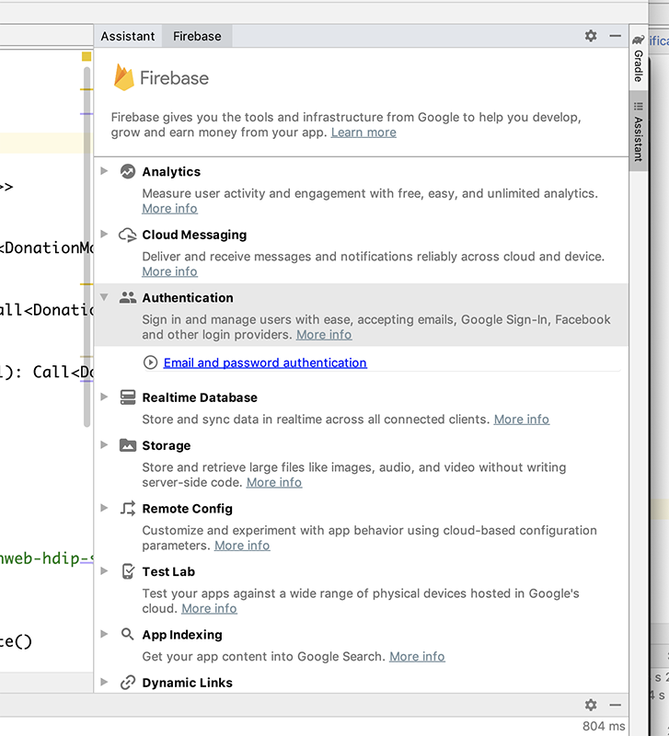
3. Setup Firebase in your App

Slide 21
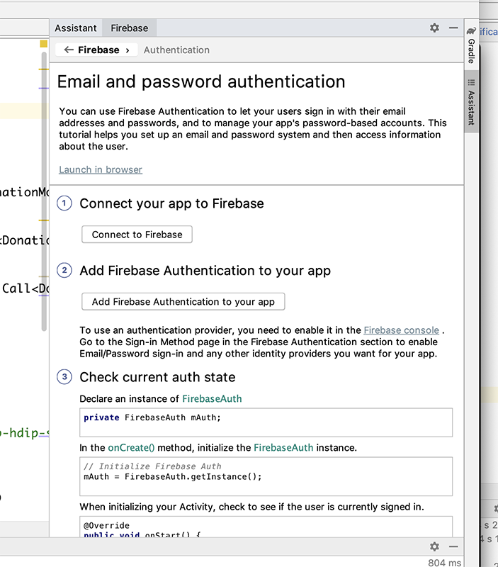
3. Setup Firebase in your App

Slide 22
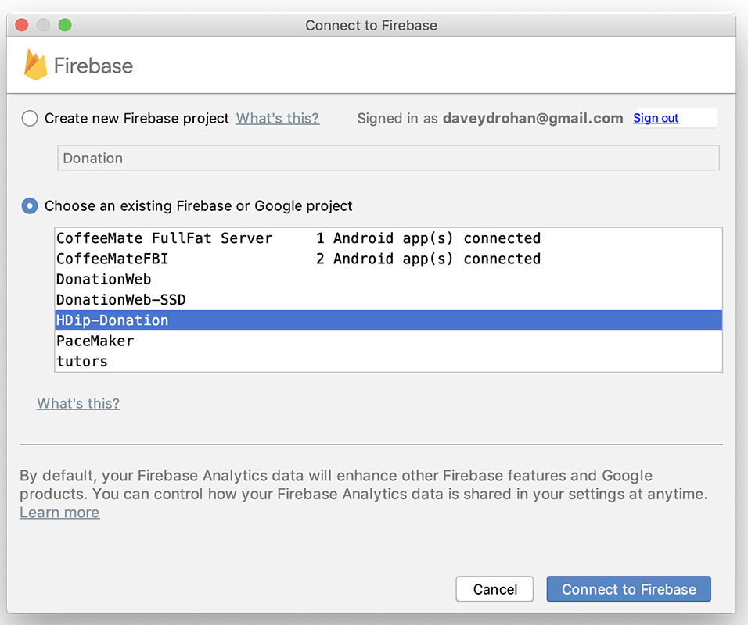
3. Setup Firebase in your App

Slide 23
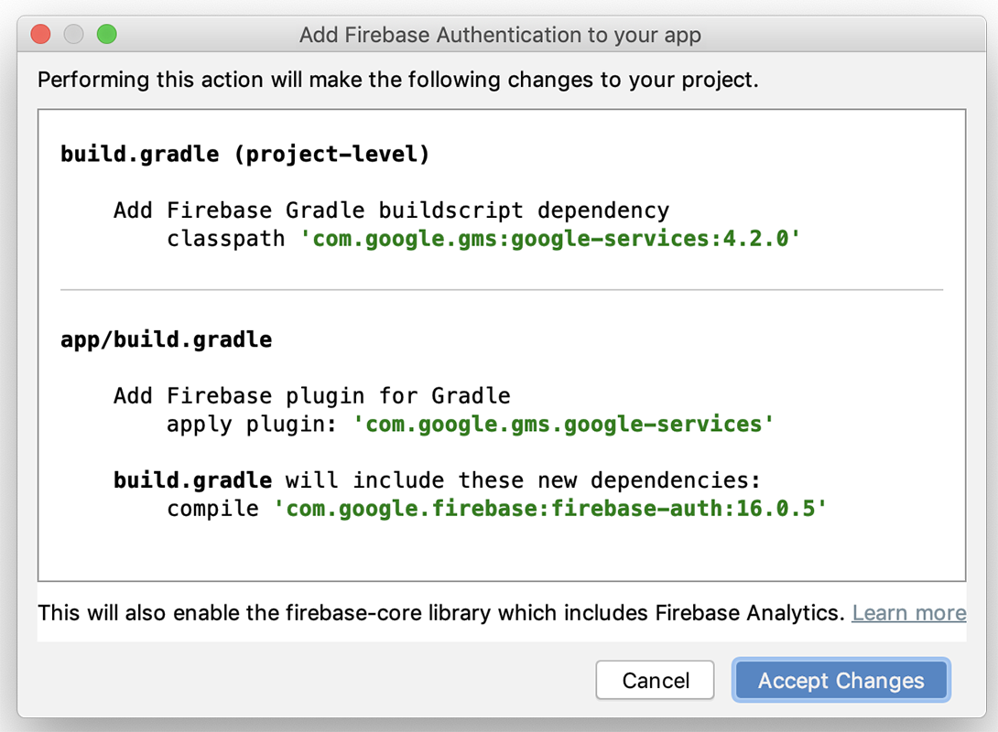
3. Setup Firebase in your App

Slide 24
4. Introduce Authentication Flow
https://github.com/firebase/quickstart-android

Slide 25
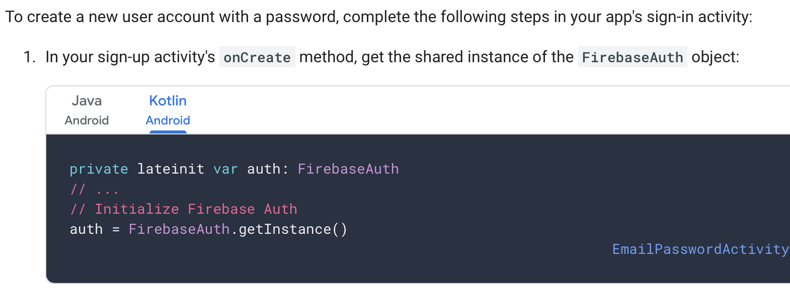
4. Introduce Authentication Flow – Create Account

Slide 26
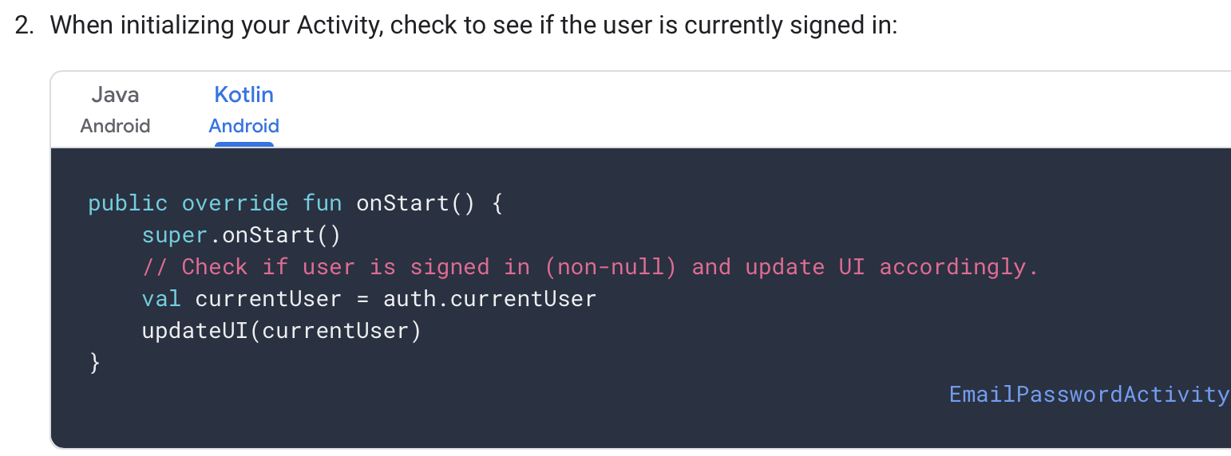
4. Introduce Authentication Flow – Create Account

Slide 27
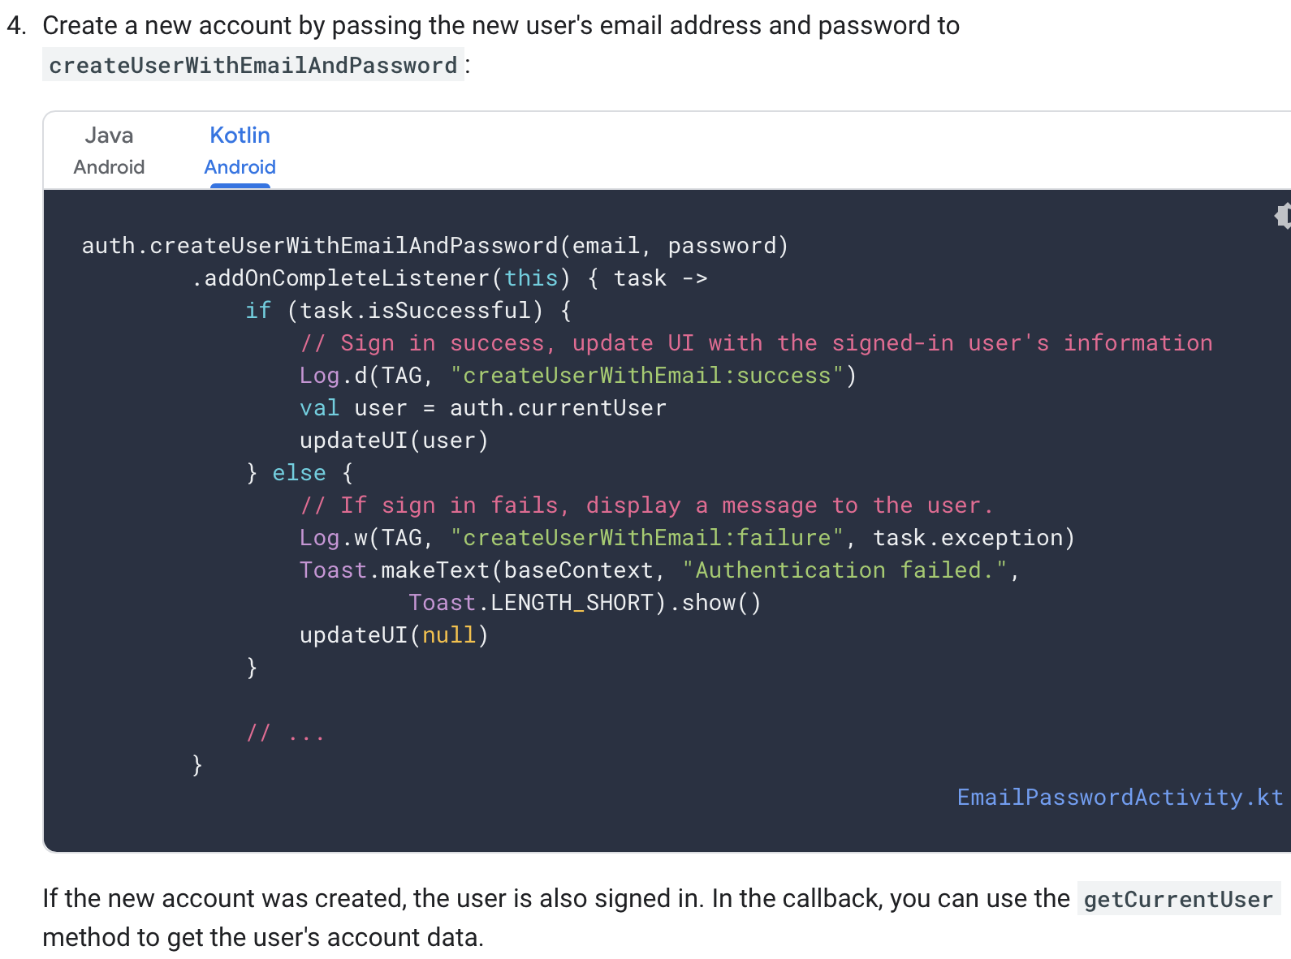
4. Introduce Authentication Flow – Create Account

Slide 28
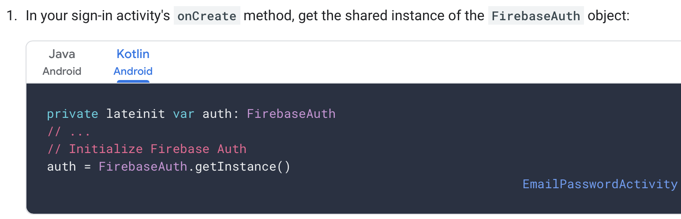
4. Introduce Authentication Flow – Sign In a User

Slide 29
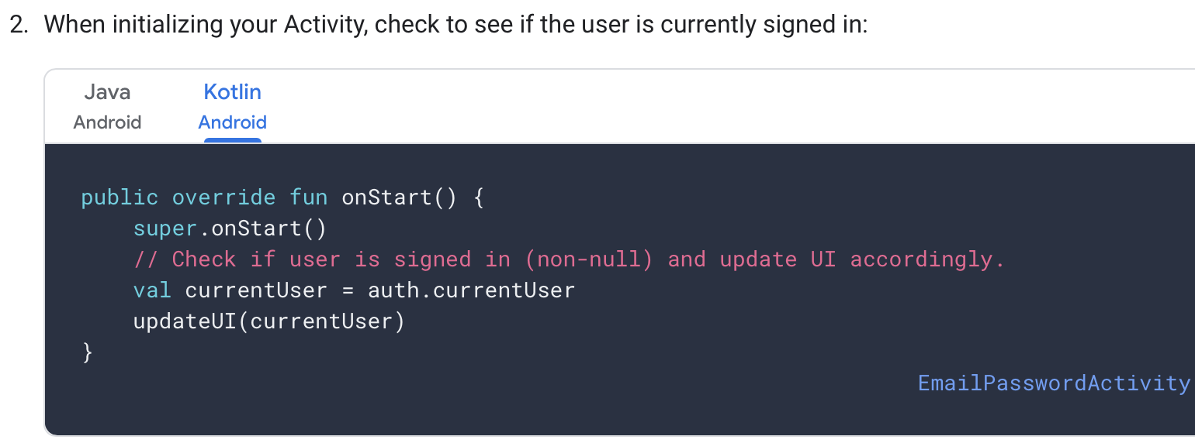
4. Introduce Authentication Flow – Sign In a User

Slide 30
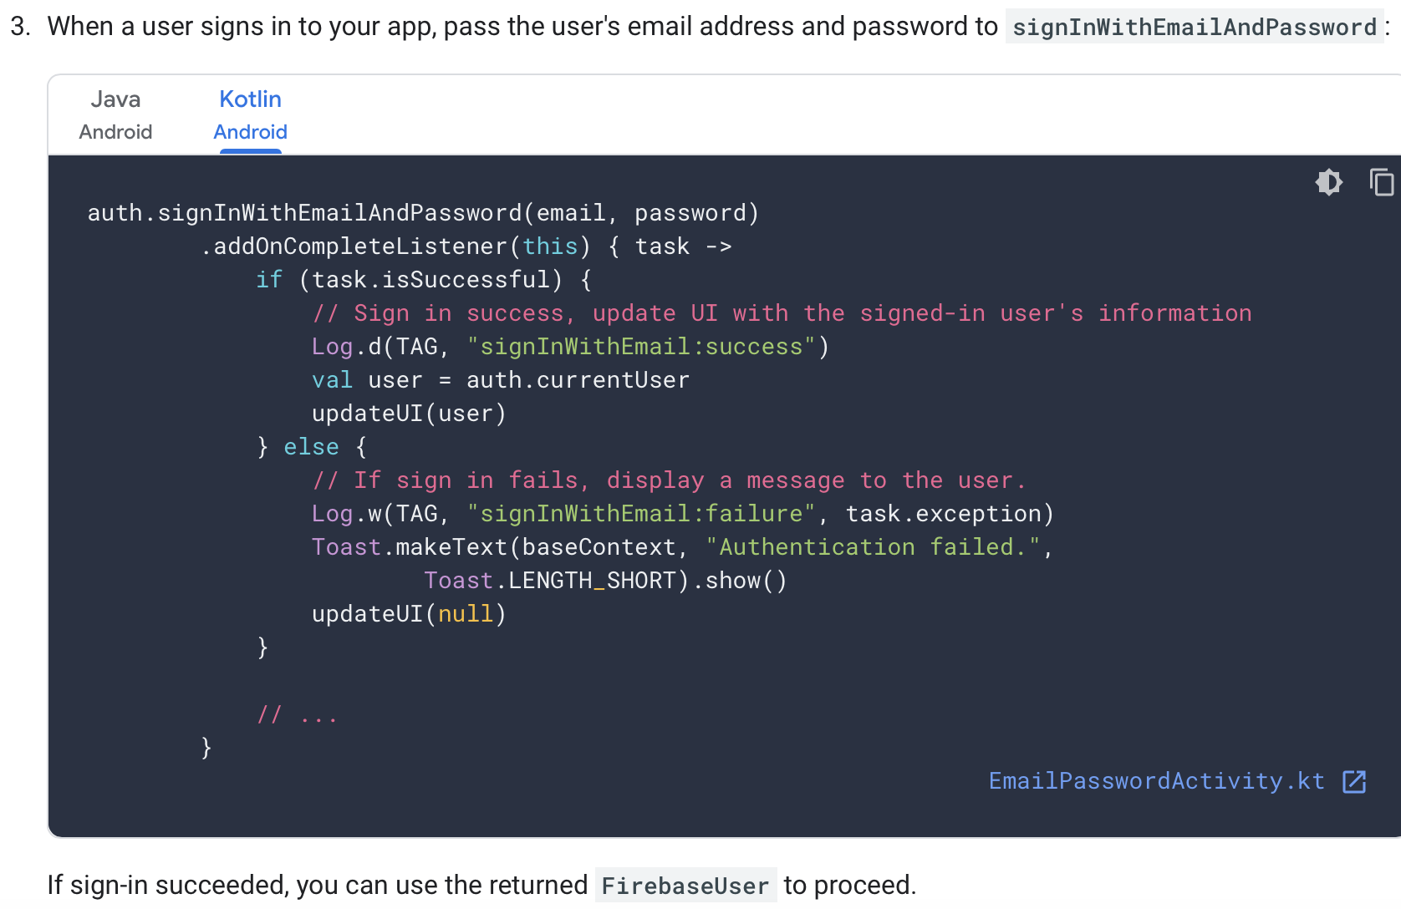

Slide 31
We’ll look at what we do with the authenticated user in the Code walkthrough and the Lab

Slide 32

References
https://console.firebase.google.com/
https://firebase.google.com/
https://github.com/firebase/quickstart-android

Slide 33


